Slide 1
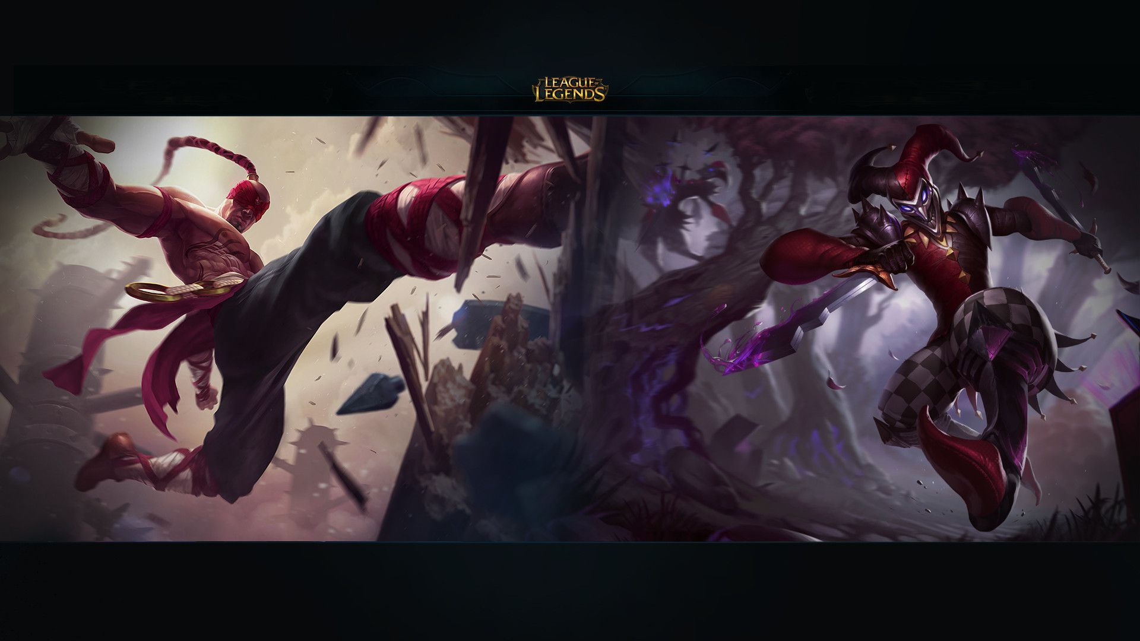


Predicting League of Legends Game Analytics
BY: Group 18

Slide 2
INTRODUCTION
An analysis tool for the popular online game League of Legends. The system is designed to help players analyze previous games and, using personalized trends, generate suggestions on the optimal way to approach a current game or how best to improve in the future.

Slide 3
CONTRIBUTION
TIPSI JADAV - 201801091 | LEADERBOARD, HOW TO PLAY BACKEND COLLECT LEADERBOARD DATA FROM RIOT API NON - FUNCTIONAL REQUIREMENTS USER STORIES PRIORITIZATION BLACK BOX TESTING SEQUENCE DIAGRAM PPT AND FINAL SRS COMPILATION
VRUSHTI DHOLA - 201801137 | TIER LIST, PERSONAL STATS BACKEND NON - FUNCTIONAL REQUIREMENTS BLACK BOX TESTING ACTIVITY DIAGRAM
DHRUV CHAVDA - 201801151 | DASHBOARD, LOGIN, LEADERBOARD, CHAMPIONS DETAILS, SUGGESTIONS FRONTEND INTERVIEW DEPLOYMENT DIAGRAM DEMO VIDEO
MAYANK HARNESHA - 201801223 | HOW TO PLAY FRONTEND GUI TESTING SEQUENCE DIAGRAM STATE DIAGRAM

Slide 4
CONTRIBUTION
MEET DADHANIA - 201801254 | UPCOMING OR ACTIVE LEAGUE INFORMATION, PERSONAL STATS BACKEND COLLECTING UPCOMING OR ACTIVE LEAGUE DATA FROM RIOT API
BHARGAV DAVE - 201801402 | DASHBOARD, ITEMS PAGE, PERSONAL STATS, COMPARE PAGE FRONTEND DOMAIN REQUIREMENTS LITERATURE REVIEW DEMO VIDEO
KRUTARTH PATEL - 201801429 | LOGIN, ITEMS PAGE, DOWNLOAD APP PAGE FRONTEND GUI TESTING STATE DIAGRAM SEQUENCE DIAGRAM
DEEP PATEL - 201801443 | LOGIN/REGISTRATION, SUGGESTIONS, COMPARISON BACKEND COLLECT CHAMPION DATA FOR A PARTICULAR SUMMONER NAME FUNCTIONAL REQUIREMENTS USE CASE DIAGRAM

Slide 5
CONTRIBUTION
PARTH BHOI - 201801464 | REAL TIME ANALYSIS APP COLLECT CHAMPIONS, SUMMONER, ITEMS DATE FROM RIOT API FUNCTIONAL REQUIREMENTS INTERVIEW DEMO VIDEO
BHARGAV PATEL - 201801465 | REAL TIME ANALYSIS APP GOOGLE FORM USE CASE DIAGRAM

Slide 6
OBJECTIVES
The main objective of this project to build a website that can help new and less experienced player who don’t have much idea about League of Legends.
This website will help players to get suggestions for their future games based on their past performances.
Users can download app from the website, with the help of that they can get real time match analysis.
They can compare their current stats with other players.
Users who are new to the League of Legends game can learn how to play the game.

Slide 7
Milestones
Sprint 1 :
Build a basic GUI to understand the usability of our website,
Downloaded API assets.
Sprint 2 :
Basic React model for our GUI, with Login and Signup along with statistics and some other functionalities.
API data extraction (Cleaning of data).
Sprint 3 :
Finalized the GUI with all functionalities.
Real Time Game analysis tool for windows.

Slide 8
TECH STACK
ReactJS with Material UI for Frontend
Django for Backend
Riot API
Pythonanywhere for Deployment
Tkinter for Windows GUI

Slide 9
TAKE AWAY FROM PROJECT
Having a process model, and a plan is always helpful
Divide and conquer
We should use GitHub more often to keep up with the progress of our project
Always explore for better ways
Communicate more, help your peer

Slide 10
ACHIEVEMENTS
Learnt how to use GitHub and manage project.
Learnt frontend and backend frameworks like React and Django.
Got some insights about the real life software development process.
Learnt how to handle conflicts among group members.
We came out with better communication skills by the interaction in our group.

Slide 11
MISTAKES
Loading animations could have added at the times of data fetching from the backend.
We could have improved on better file organization.
We could have maintained separate flows(repos) for both backend and frontend to avoid any possible conflicts.
We could have improved on quality of our our work if we would have followed the documentations from the beginning rather than starting later.
Reviewing code before committing to repo could have been a better option.

Slide 12
OVERALL RATING OF SOFTWARE
8.5/10

Slide 13
RATING OF SOFTWARE ARTIFACTS
Rating of Software Artifacts : 4/5

Slide 14
GITHUB REPOSITORY https://github.com/tipsi2022/Group18-Predicting-League-of-Legends-Analytics.git
WEBSITE LINK
https://tinyurl.com/LoL-Analytics

Slide 15
DEMO OF PROJECT

Slide 16
THANK YOU

